Slide 1
Beyond Technology Information Systems in an Organizational Context
Jay Wang
January 20, 2017

Slide 2
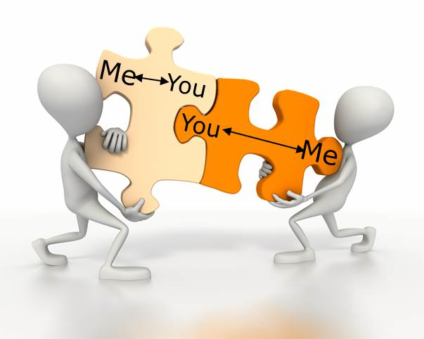
Objective & Agenda
“Knowledge is power.” – Francis Bacon (1597)
Knowledge Sharing
What I learned from RMU Doctoral Program
SEME Alignment
Systems Thinking
Social-Human SE
Model-Oriented SE
Change-Based SE
Agenda
Part I – The Purpose of Info. Systems
Part II – The Models of Info. Systems
Knowledge sharing is powerful and empowering.
Notes:
I started a doctoral program in Information Systems and Communications last year. I finished one semester and is in the middle of the second semester.
I have learned a great deal about information systems especially in social and organizational context. This presentation is for me to share with you what I have learned.
I would like t o share with you a new way of looking at an information which goes beyond technology. This new perspective will help us develop better information systems that are impactful.
I also like share with you the interdisciplinary nature of information systems and how theories from other disciplines can help us investigate the multiple perspectives of information systems.

Slide 3
Part I – The Purpose of Information Systems
The Why

Slide 4
Is A Lawn mower an Information System?
There are many definitions of Information Systems. All are insightful and useful. Below are two examples.
UKAIS*
CMU SEI*
“the means by which people and organizations, utilizing technologies, gather, process, store, use and disseminate information.”
“any combination of information technology and people’s activities using that technology to support operations, management, and decision-making.”
* UKAIS – United Kingdom Academy of Information Systems
* CMS SEI – Carnegie Mellon University Software Engineering Institute

Slide 5
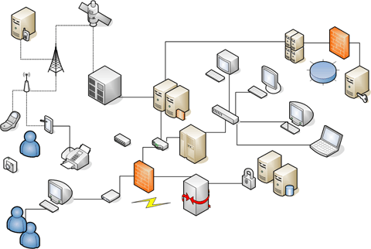
Traditional Systems engineering View
Software
Applications
Operating Systems
Hardware
CPU
Memory
Communication
Media
Data
Users
Notes:
System thinking from technical perspective.

Slide 6
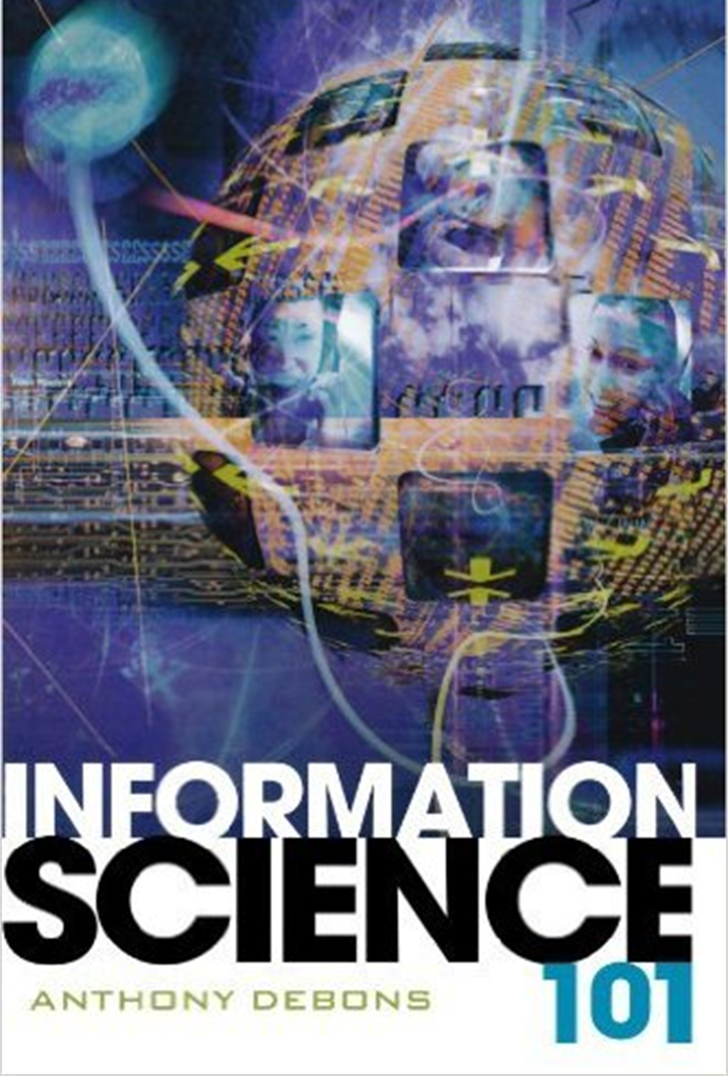
A Poem about Information
Birth is the start of information; Death the end.
From then to now, symbols command;
Symbols give essence to presence;
Through presence, meaning.
- By Anthony Debons
Takeaway:
Information is symbol with meaning.
Information is the essence of human life.

Slide 7

The Paradox of Technical Efficiency & Organizational Ineffectiveness
“I worked in public administration and then in industry where I experienced computers being used with great technical skill but with only poor results for the client organization. There seemed to be one overwhelming reason for this technical efficiency combined with organizational ineffectiveness: we knew all about information technology but precious little about the information it carried. We could produce bottles but we did not understand the wine.”
– Ronald Stamper, British computer scientist, “A semiotic theory of information and information systems”
Notes:
Talk about the experience at Fremont Plastic Product Inc. Workers waited outside the office building on a Friday evening waiting for the paychecks while I was work to fix the technical issues. The impact of information systems on people’s life.
My first-hand experience of the reality of low-wage workers and how they live from paycheck to paycheck.

Slide 8
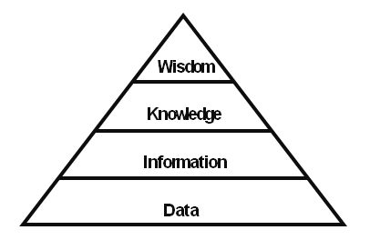
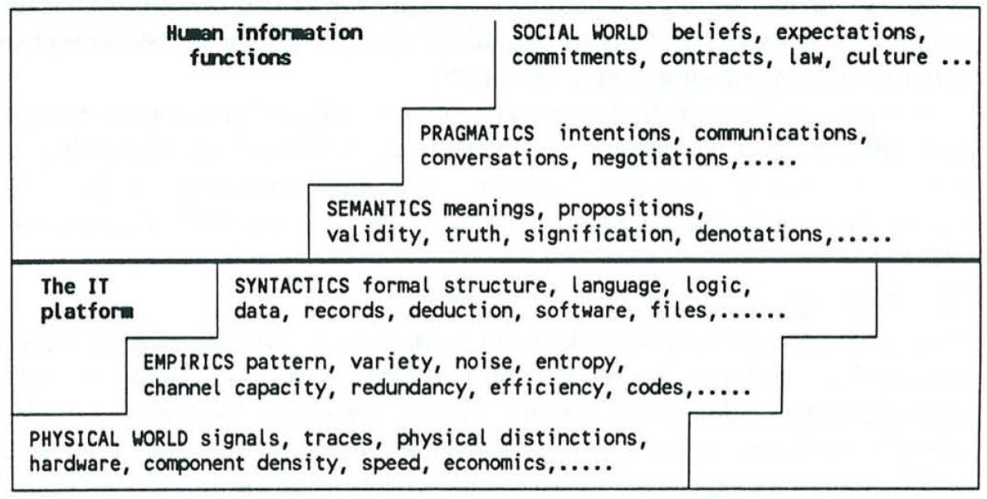
Stamper’s Semiotic Ladder
Social-Human
SE
The lower half is technical. The upper half is social and humanistic.
Bits & Bytes
DIKW Hierarchy
(Data, Information, Knowledge, Wisdom)
https://en.wikipedia.org/wiki/DIKW_pyramid
Stamper, R. (1996). Signs, Information, Norms and Systems. In R. Posner, H. Klein, P. B. Andersen, & B. Holmqvist (Eds.), Signs of Work: Semiosis and Information Processing in Organisations (pp. 349-398): De Gruyter.
Notes:
Semiotics is the study of signs and their significance or meaning.
Semiotics is an investigation into how meaning is created and how meaning is communicated. Its origins lie in the academic study of how signs and symbols (visual and linguistic) create meaning.
Information system is also a communication system. User interface, user manual, design documents, help desk, etc.

Slide 9
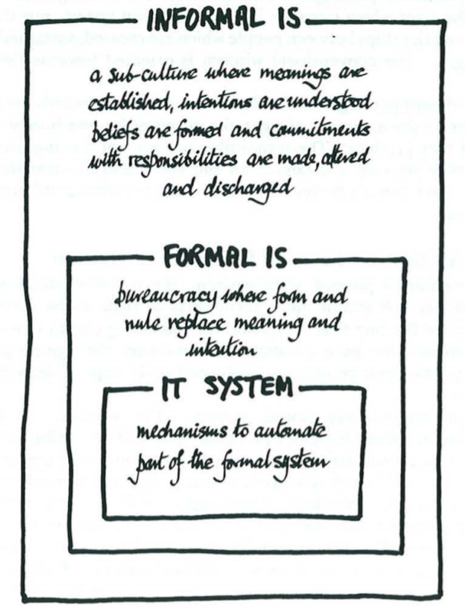
Stamper’s Organizational “Onion”
The work performed that provides meaningful values & impactful outcomes to the sponsor
Informal IS
Three layers of an information system
IT System
Formal Info System
Informal Info System
Policies & procedures about time recording
Formal IS
MITRE Time Recording System (TRS)
IT System
Stamper, R. (1996). Signs, Information, Norms and Systems. In R. Posner, H. Klein, P. B. Andersen, & B. Holmqvist (Eds.), Signs of Work: Semiosis and Information Processing in Organisations (pp. 349-398): De Gruyter.

Slide 10
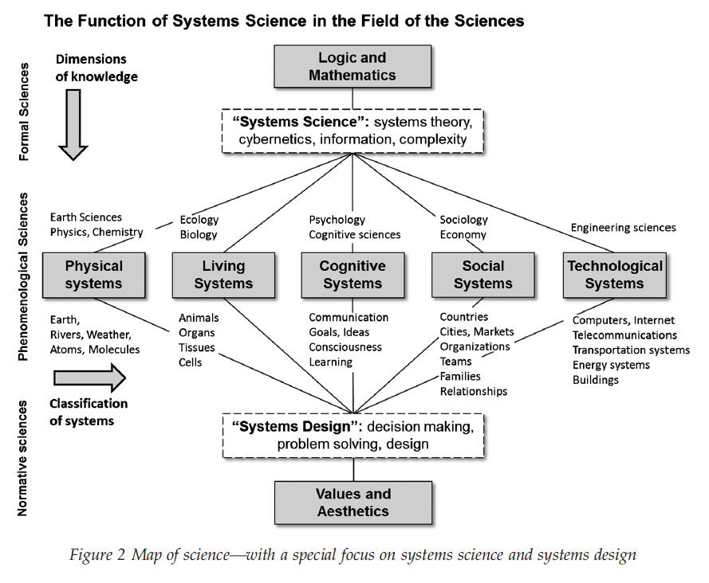
Information system is Interdisciplinary
Systems Thinking
Social-Human
SE
Intersection of three systems
Technical system
Cognitive system
Social system
Intersection of many disciplines
Engineering
Computer science
Cognitive science
Management science
Social science
Information System
Hieronymi, A. (2013). Understanding systems science: A visual and integrative approach. Systems research and behavioral science, 30(5), 580-595.

Slide 11
Examples of Theories Used in Information systems Research
Theory | Description | Author | Discipline
Information Processing Theory | The limit of human capacity to process information. Seven plus/minus two rule. | Miller (1956) | Cognitive psychology
Diffusion of Innovation Theory | Dynamic process of technology adoption. Innovators, early adopters, early majority, late majority, laggards. | Rogers (1962) | Sociology
Agency Theory | The principal-agency problem. Alignment of goals and mechanism of incentives. Manager/subordinates relationship, management of IT outsourcing. | Alchian and Demsetz (1972) | Economics
Soft Systems Methodology | An agile (collaborative and iterative) approach to solve problems that are not well defined. CATWOE method (Customers, Actors, Transformation, Worldview, Owners, Environment) | Checkland (1981) | Systems science
http://is.theorizeit.org/wiki/Main_Page (Theories Used in Information Systems Research Wiki)

Slide 12
The Disconnect between Information systems Research & Practices
Practitioners can learn from researchers and apply the body of knowledge to improve practices.
Areas of Information Systems Research
Areas of Information Systems Practices
Psychology
Cognitive science
Economics
Sociology
Management science
Systems science
Political science
Software engineering
Hardware engineering
Network Engineering
Systems engineering
Data Analytics
Usability Engineering
Engineering management

Slide 13
Part II – The models of Information Systems
The What & How

Slide 14
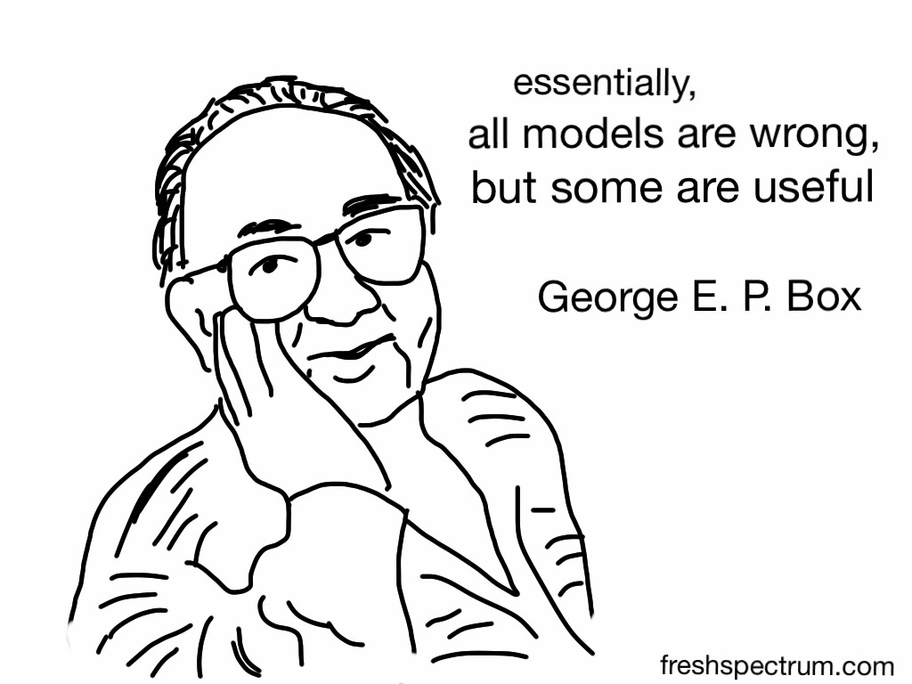
Three Useful Models of An Information System
DeLone & McLean Success Model
Work System Method (WSM) Model
Technology-Organization-Environment (TOE) Model
Notes:
George Box is "one of the great statistical minds of the 20th century"

Slide 15
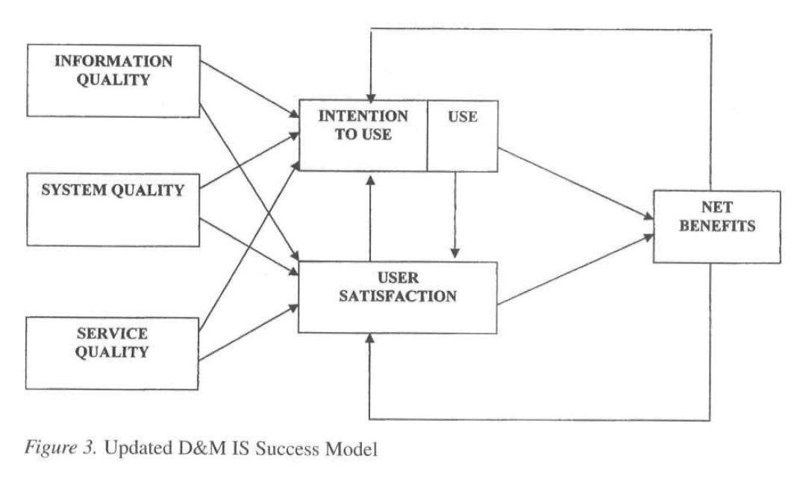
Information Systems Success Model
Social-Human
SE
Model-Oriented
SE
DeLone & McLean in 1992
Updated in 2003
Technology-oriented
Based on Shannon-Weaver’s Model of Communication
Measures IS success (effectiveness)
DeLone, W. H., & McLean, E. R. (2003). The DeLone and McLean Model of Information Systems Success: A Ten-Year Update. Journal of Management Information Systems, 19(4), 9-30.

Slide 16
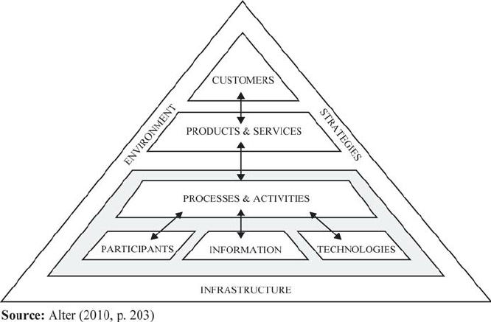
Work System Method (WSM)
Model-Oriented
SE
Steven Alter, University of San Francisco
Business-centric
IT is secondary
Info. & Tech as a means not an end
Focus on outcome & impact
The ultimate goal is customer satisfaction
Alter, S. (2002). The work system method for understanding information systems and information systems research. Communications of the Association for Information Systems, 9.

Slide 17
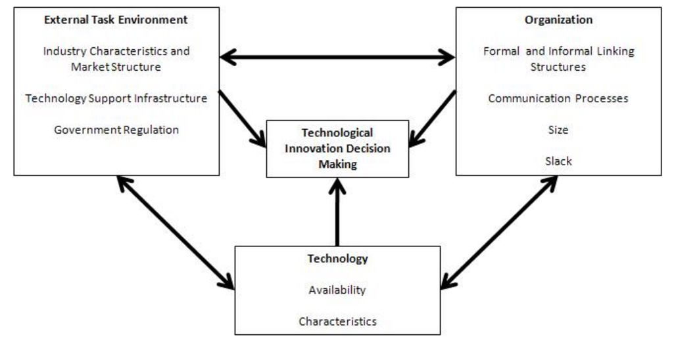
Technology-Organization-Environment (TOE) Framework
Model-Oriented
SE
Technology Adoption by an organization
Technical context
Organizational context
Environmental context
Tornatzky, L. G., Fleischer, M., & Chakrabarti, A. K. (1990). The processes of technological innovation. Lexington, Mass.: Lexington Books.

Slide 18
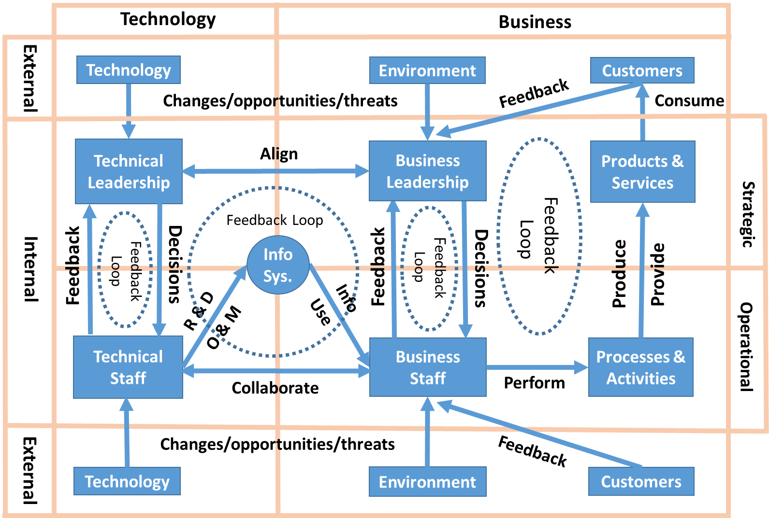
Wang’s Unified Model
Systems Thinking
Social-Human
SE
Model-Oriented
SE
Change-based
SE
Technology is only one piece in a puzzle of a sociotechnical system
Information system is at the intersection of technology and business, operations and strategies in an organization
An organization is an open system with internal dynamics under external influences
Information system is a complex adaptive system that requires
Feedback loops
Internal integration
External adaptation

Slide 19
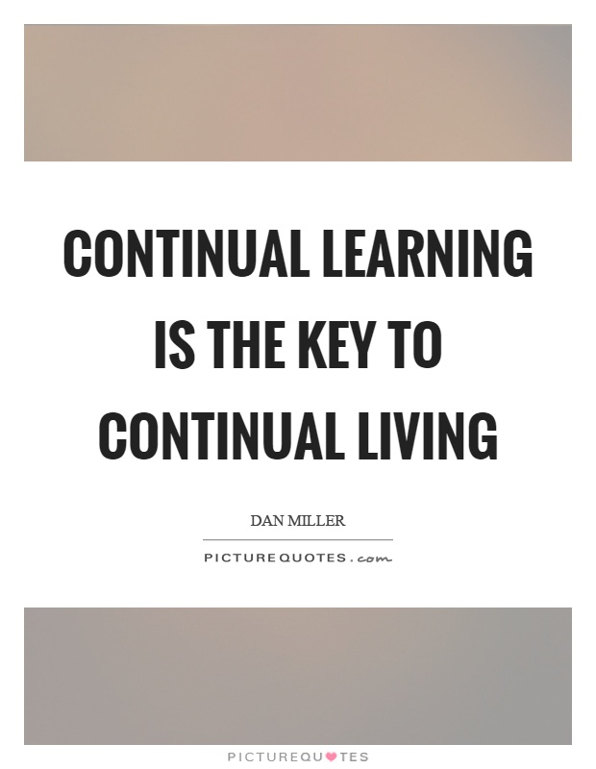
Wang’s Unified Model -Learning is living
Feedback loops require learning
Responding to the external forces of changes requires learning
The collaboration and alignment between IT and business require learning
Learning is what keeps a Complex Adaptive System (CAS) alive and thrive
Be a lifelong learner in a learning organization

Slide 20
Wang’s Unified Model - Six Dimensions
A model is an approximation and simplification of the reality.
It provides lenses to help people explore and understand the reality.
Technology
Rapid innovation
Business
Quality of products and services
System life-cycle management
Systems quality
Information quality
Usability & user satisfaction,
Profit & Loss
ROI of IS/IT
Business performance
Customer satisfaction.
Operational
Operational efficiency
Strategic
Organizational effectiveness
Worker productivity
Financial performance
Competitive edge
Long-term goals and vision,
Mission & purposes.
Cost savings
Business continuity
Internal
IT and business collaboration, cooperation, and alignment to achieve seamless internal integration
External
Adaptation to changes in technology, laws and regulations, industry trends, market conditions, competitions, and customer needs.
Power, politics, conflict resolution
Management support

Slide 21
Application of The Unified Model (1) - Understand The mind and mission of a CIO
“We initiated the reorganization to respond to new developments in information technology, to help make decisions to adopt new solutions, and to improve the quality of our services to the EPA customers and mission. The new organization will help us promote the use of agile and user-focused development methodologies, and to ensure we have customer advocacy built into our organizational structure.”
– EPA CIO Ann Dunkin
Analysis using the model
“to respond to new developments in information technology, to help make decisions to adopt new solutions” – Responding to technology changes
“to improve the quality of our services to the EPA customers and mission” – Improving IT/IS service quality; IT alignment with business
“to promote the use of agile and user-focused development methodologies” – User & business centric; agile methodologies for improved IT/business collaboration
“to ensure we have customer advocacy built into our organizational structure” – feedback loops and IT/business alignment
http://www.federaltimes.com/story/government/management/agency/2016/07/01/epa-cio-embracing-agile-development/85356850/

Slide 22
Application of The Unified Model (2) - Understand Information System Obsolescence
This model provides a framework for exploring the phenomenon of information system obsolescence
Technology Obsolescence
Inadequate response to the rapid technology innovations
Functional Obsolescence
Inadequate response to changes in business and customer needs
Systems outlive the lives of technologies used
Lack of desire/required functionalities
Lack of user satisfaction
Systems grow in complexity
Professional Obsolescence
Insufficient learning and training to update knowledge and skills of IT professionals
Organizational Obsolescence
Poor collaboration, cooperation and alignment of IT and business
Insufficient response to changes in internal dynamics and external environment
Organizational inertia and complacency
The shortage and aging of IT workforce
Insufficient knowledge management

Slide 23

Think Beyond Technology
“Despite our faith in technology and our reliance on technological solutions, there are no technical solutions to most of the problems confronting human beings.”
– Edward T. Hall, 1976, Beyond Culture

Slide 24
Bibliography
Alter, S. (2002). The work system method for understanding information systems and information systems research. Communications of the Association for Information Systems, 9.
Alter, S. (2006). The work system method: connecting people, processes, and IT for business results. Larkspur, California, US: Work System Press.
Debons, A. (2008). Information science 101. Lanham, Md.: Scarecrow Press.
DeLone, W. H., & McLean, E. R. (1992). Information Systems Success: The Quest for the Dependent Variable. Information Systems Research, 3(1), 60-95.
DeLone, W. H., & McLean, E. R. (2003). The DeLone and McLean Model of Information Systems Success: A Ten-Year Update. Journal of Management Information Systems, 19(4), 9-30.
DeLone, W. H., & McLean, E. R. (2004). Measuring e-Commerce Success: Applying the DeLone & McLean Information Systems Success Model. International Journal of Electronic Commerce, 9(1), 31-47.
DeLone, W. H., & McLean, E. R. (2016). Information Systems Success Measurement. Foundations and Trends® in Information Systems, 2(1), 1-116.
Edward, H. (1976). Beyond culture: New York: Anchor Books.
Hieronymi, A. (2013). Understanding systems science: A visual and integrative approach. Systems research and behavioral science, 30(5), 580-595.
Stamper, R. (1996). Signs, Information, Norms and Systems. In R. Posner, H. Klein, P. B. Andersen, & B. Holmqvist (Eds.), Signs of Work: Semiosis and Information Processing in Organisations (pp. 349-398): De Gruyter.
Tornatzky, L. G., Fleischer, M., & Chakrabarti, A. K. (1990). The processes of technological innovation. Lexington, Mass.: Lexington Books.

Slide 25

Questions & Discussions

